Slide 1
Operating Systems
Introduction of OS
Services provided by an OS
Structure of an OS (Kernel & Shell)
Types of Kernel
Dr. Dinesh C. Dobhal

Slide 2
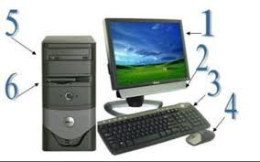
Before answering the question What is OS? Or Why OS is required? Answer
Where OS is found?
Why Computer is required?
For working of the computer, all of its components must work in controlled and coordinated way……
Keyboard, Screen, Mouse, Speaker, Hard Disk, RAM, USB Pen Drive, etc.
Who is going to control?
A Controller, which will control the components of the computer, is required. It may be H/W or S/W.

Slide 3
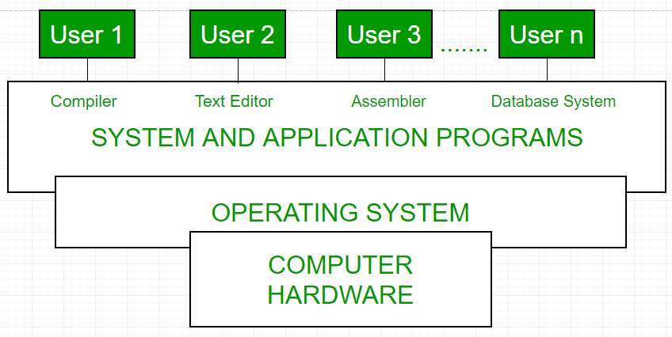
Components of Computer System
Operating system?
System Software, which provides an interface between Hardware and the user and control functionalities of various components of the computer.

Slide 4
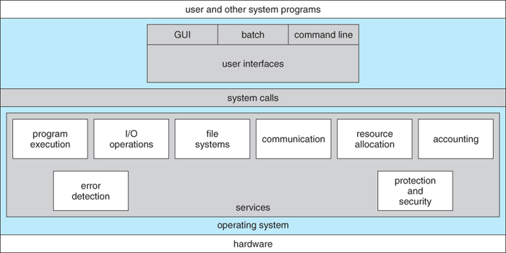
Operating System Services

Slide 5
Operating System Structure
Kernel is the core of the operating system that controls all the tasks of the system.
Shell is the interface that allows the users to communicate with the kernel.

Slide 6
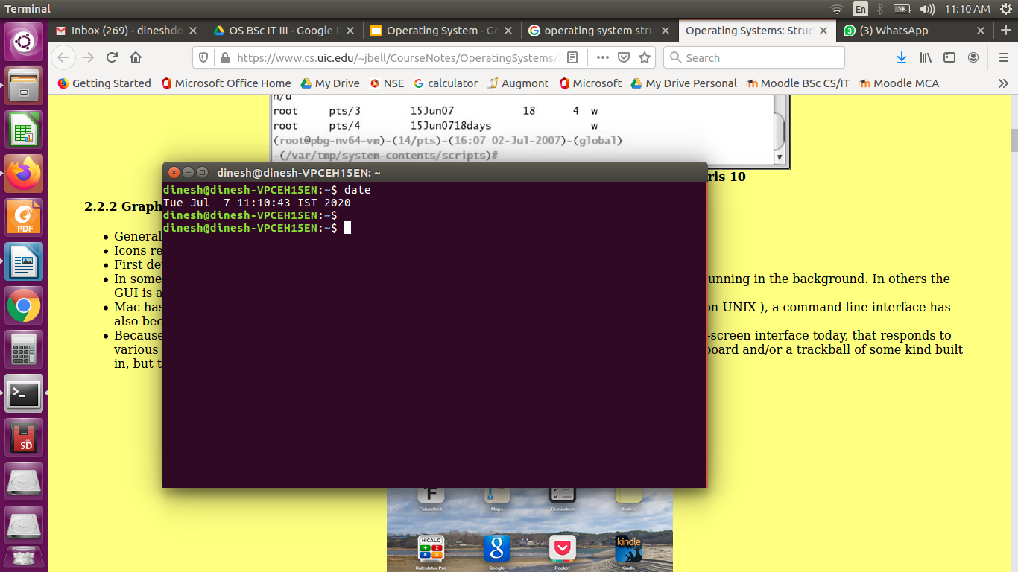
Character User Interface (CUI)/ Command Line

Slide 7
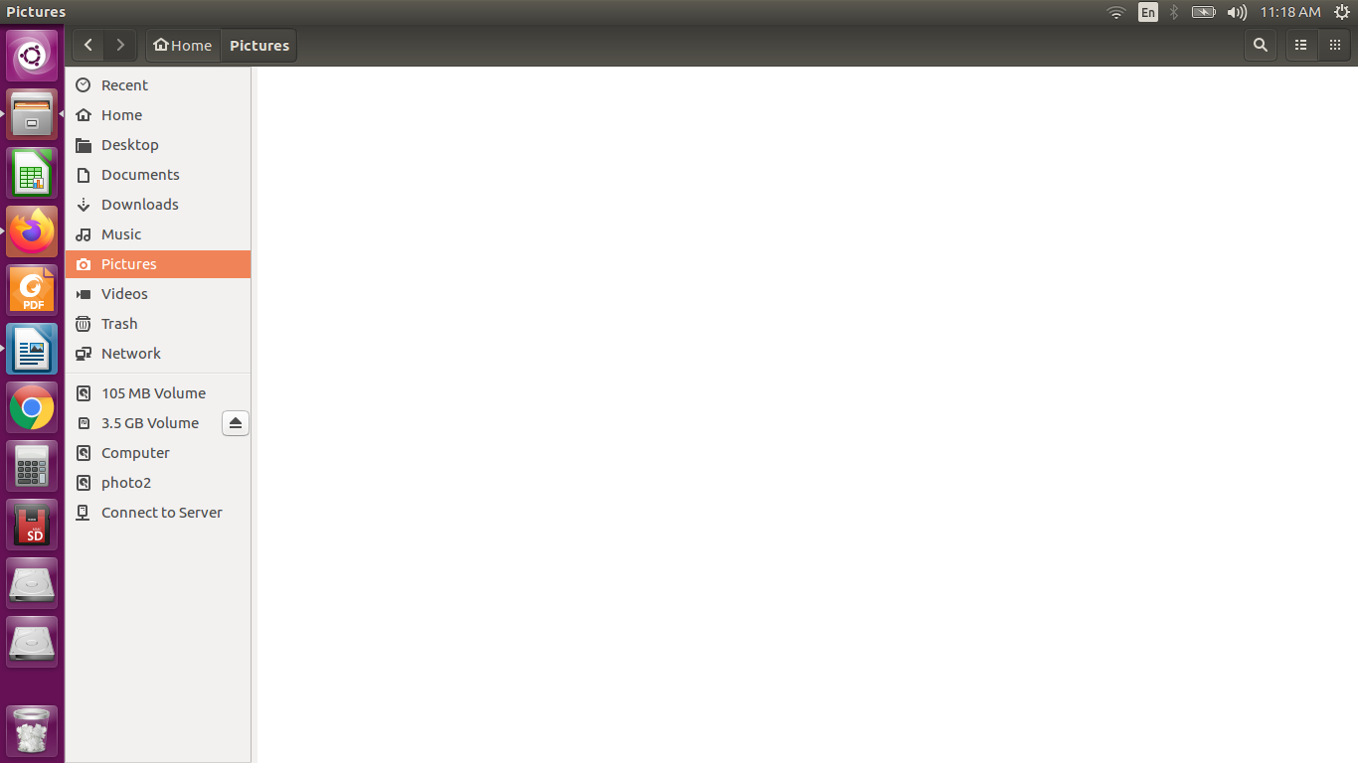
Graphical User Interface (GUI) / Desktop

Slide 8
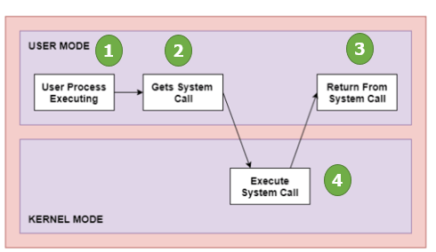
System Calls
A system call is just a kernel space function that user space programs call to handle some request. When your program wants to write to or read from a file, delete or create directory, or even to finish its work, a program uses a system call. It is an interface between a process (user program) and the operating system.

Slide 9
